Slide 1
Design of a highly Integrated Dew Point Mirror Hygrometer
Master Thesis
Midterm Presentation

Slide 2
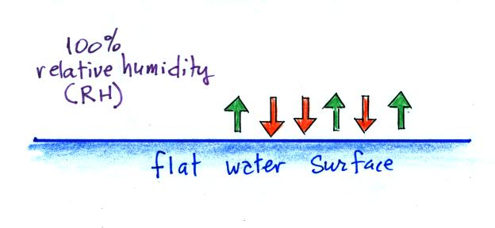
OVERVIEW - humidity
Amount of water in a gas
Described as absolute [kg/m³] or relative [%] value (to equilibrium)
Aim of this work: Development of a Dew Point Hygrometer
cost-efficient
yet highly accurate
[1]
Notes:
Steigen wir direkt ein. Ein Taupunkthygrometer ist ein gerät zur bestimmung der Luftfeuchtigkeit. Die Luftfeuchtigkeit beschreibt erst einmal ganz generell die Menge an Wasserdampf in Luft

Slide 3
OVERVIEW - HYGROMETER
Device for measurement of humidity
Different kinds: mechanical, electrical, optical, chemical
Most commonly used today:
Capacitive Sensor | Chilled Dewpoint Mirror
Capacitive measurement using a hygroscopic dielectric | Dew point temperature measurement using a cooled down mirror
+ cheap and small | + ±0.1% RH accuracy
- ±1% RH accuracy | - expensive and large
- long-term drift | - influence on measured gas

Slide 4
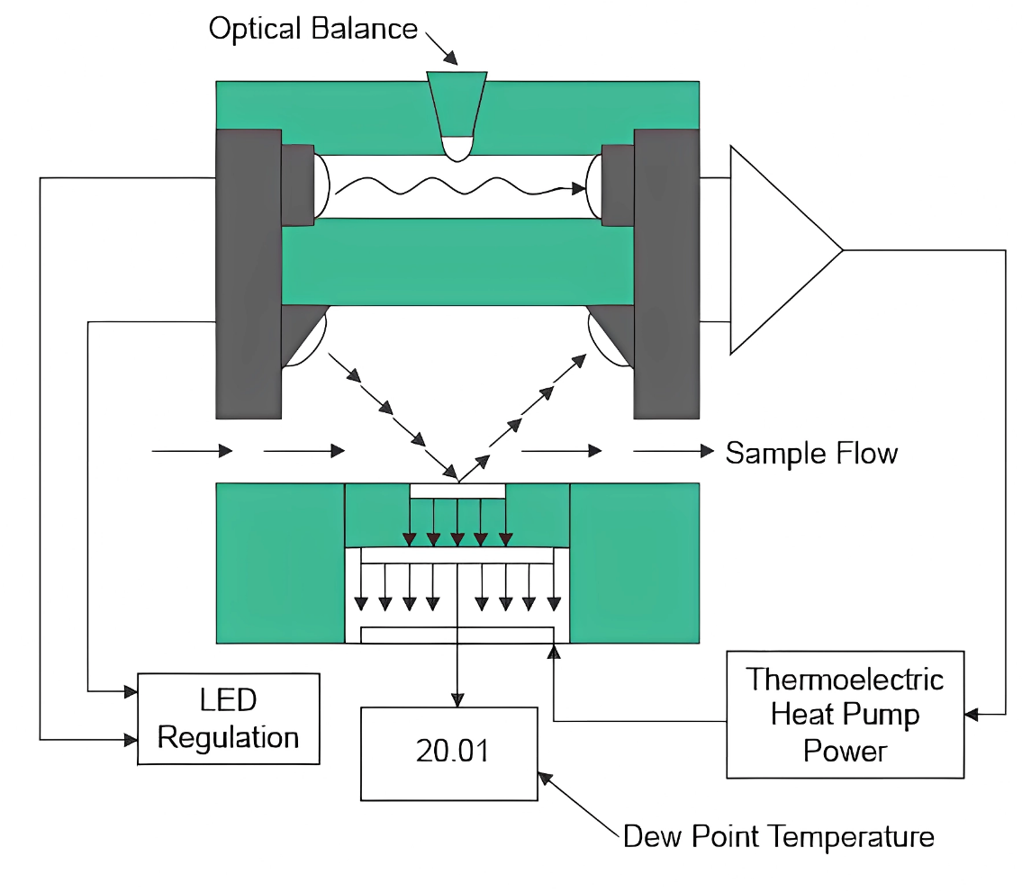
Dew Point Mirror
Mirror integrated thermal sensors (RTD)
Peltier element for cooling
Optical readout of condensate (LED/PD)
Gas flow control
[2]

Slide 5
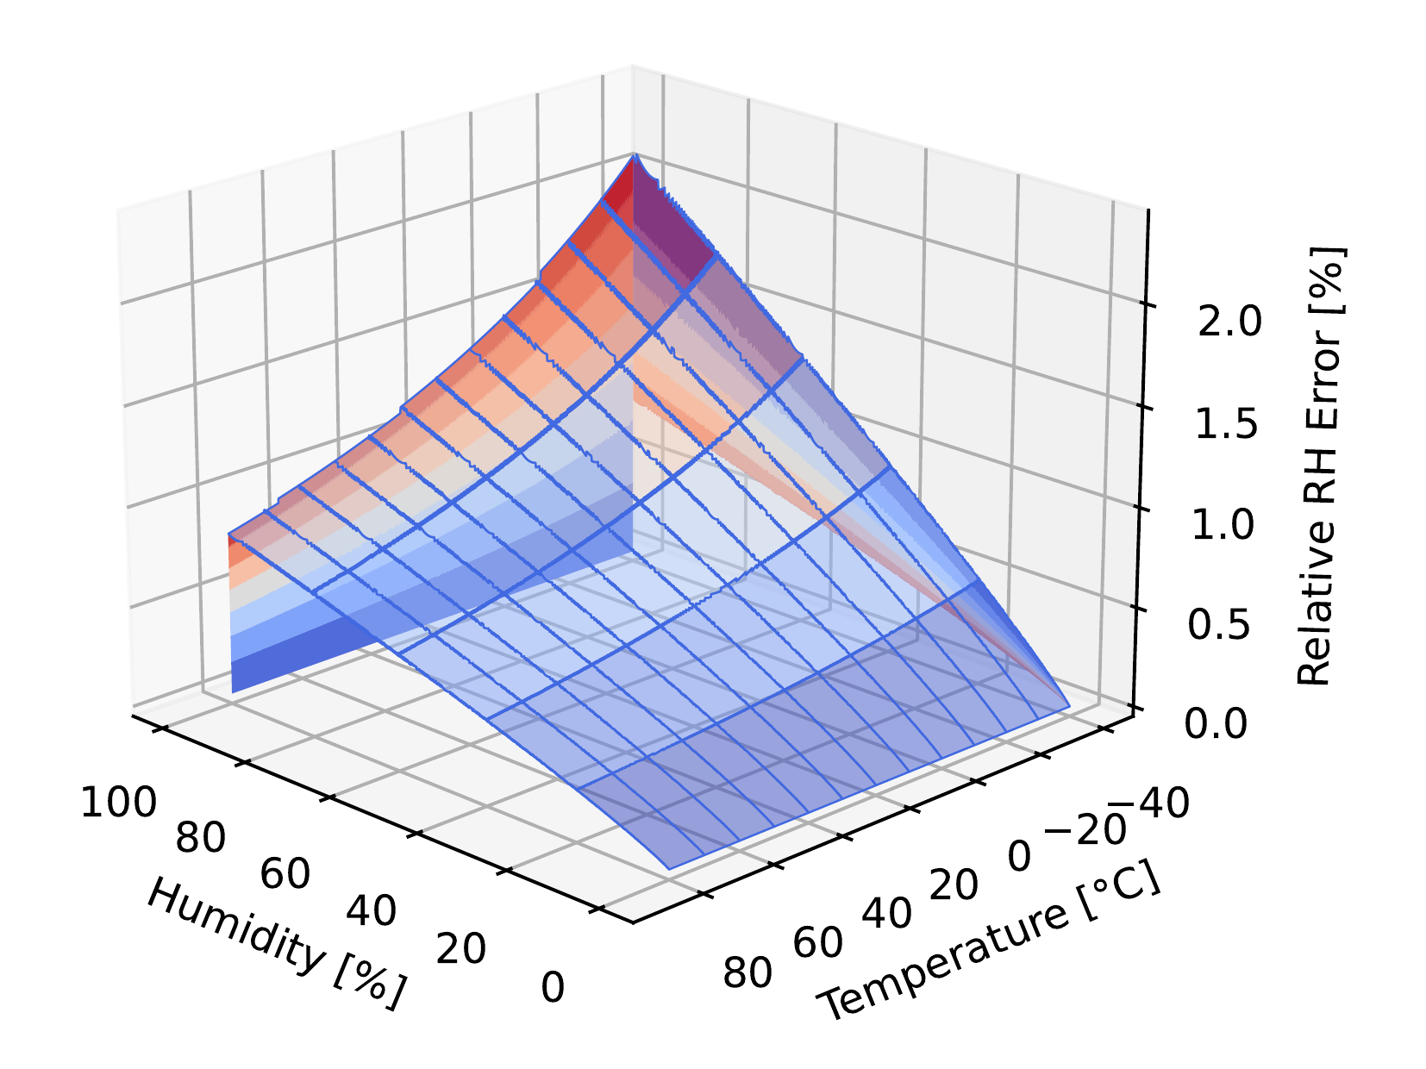
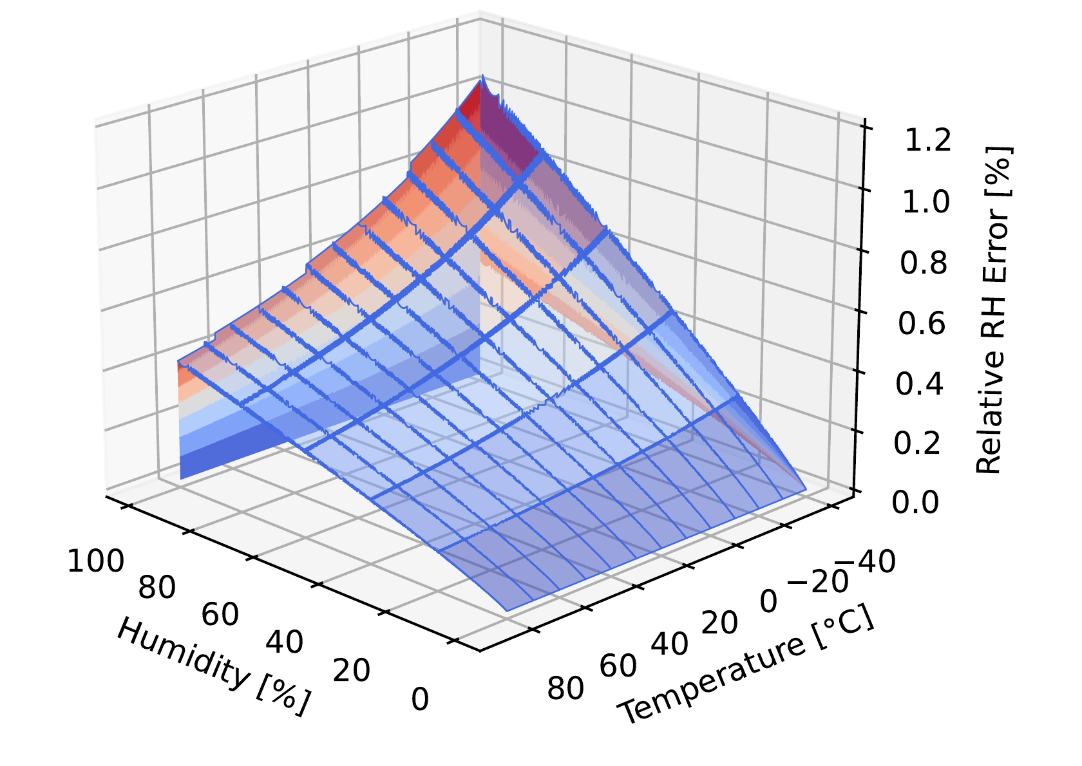
ACCURACY REQUIREMENTS
ΔT_{dew} = 0.2 °C
ΔT_{dew} = 0.1 °C

Slide 6
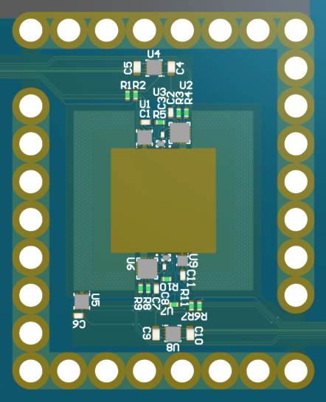
FIRST Iteration
Base PCB and Mirror FPC
3 different optical sensors:
Integrated proximity sensors
Discrete NIR LED and photodiode
4 different integrated temperature sensors
Peltier Element and Heatsink

Slide 7
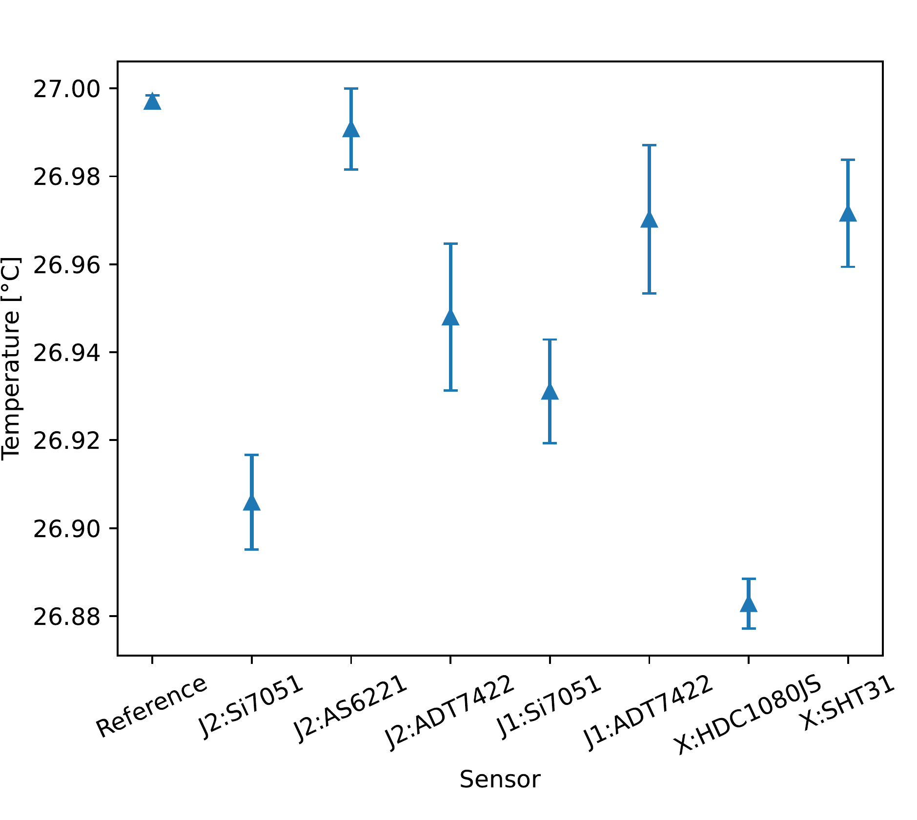
PERFORMED TESTS
Temperature Measurements
Long-term over 1.5h for 27°C
Short duration for 0°C – 60°C
Optical Readings
Comparative
With visible light source
Manual Regulation

Slide 8
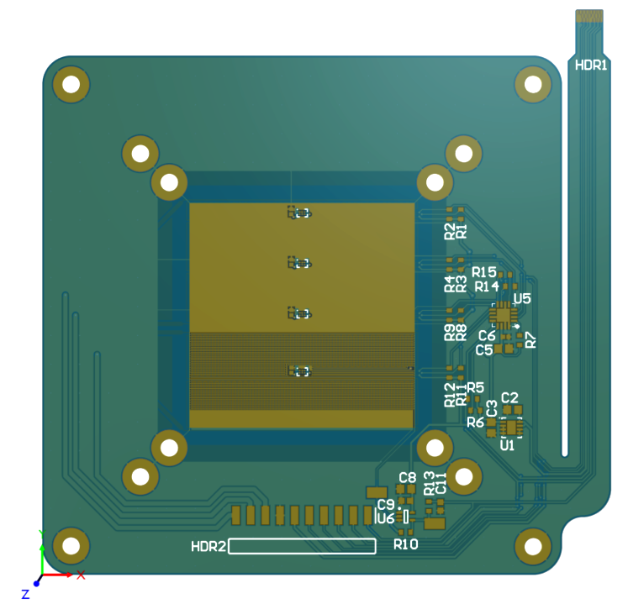
Second Iteration
Base PCB and Mirror FPC
Focus on proximity sensor as optical readout
Capacitive readout
Single temperature sensor type (AS6221)
Resistive heater
Air pressure readings

Slide 9
Open Issues
Calibration and Test Setup
Validation of optical readout
Determination of accuracy in regards to error propagation
Evaluation criteria:
Accuracy
Precision
Drift
Repeatability

Slide 10
SOURCES
[1] http://www.atmo.arizona.edu/students/courselinks/fall15/atmo170a1s2/lecture_notes/humidity/condensation_nuclei.html
[2] nach https://www.thunderscientific.com/calibration_support/

